Slide 1

US NFC Trade Receivables Forecasting
Yufei Liu 11/24/2025

Slide 2
TABLE OF CONTENTS
01
02
03
04
05
06
07
08
Problem Statement
Data Sources
Methodology
Exploration
Judgement
Recommendation
Forecast & Conclusion
Improvement

Slide 3

Problem Statement
What to forecast
US Nonfinancial Corporate (NFC) trade receivables, quarterly, billions USD
Forecast range: next 4 quarters
Why it matters
Receivables track B2B sales on credit and demand
They affect the cash conversion cycle and working capital
They affect liquidity, borrowing base, and supply chain finance costs
Better forecasts help set Accounts Receivable policy, collections targets, and cash plans
Notes:
This is the same data I used in my SCFM project. In that project, I need to estimate the size of the U.S. Supply Chain Finance market for 2023 and 2024 and figure out how big this market is in terms of total outstanding balances and annual transaction flows using consistent data and a clear method.
The reason I use the data for this project is I want to see the future possible values as well so that I can have a clearer understanding for the development of the US NFC trade receivables.

Slide 4
Data Resources
https://www.federalreserve.gov/datadownload/Review.aspx?rel=Z1&series=92e209e60418268b9a85b8d9fb11c7c9&lastobs=5&from=&to=&filetype=csv&label=include&layout=seriesrow&type=package
Time Series
How it’s compiled
U.S. Financial Accounts (Z.1), Table L.230 “Trade Credit,” specifically the Nonfinancial Corporate Business; Trade Receivables; Asset series (code FL103070005.Q).
This is quarterly data, reported in U.S. dollars. In this file, I use billions of USD for easy reading.
Time coverage:
2000 ~
The Federal Reserve aggregates sector-level financial statements and other sources into the Z.1 accounts and updates them quarterly.

Slide 5
Methodology
Decomposition
SES
Holt-Winters
ARIMA
Simple Exponential Smoothing
Accuracy Summary
MAPE

Slide 6
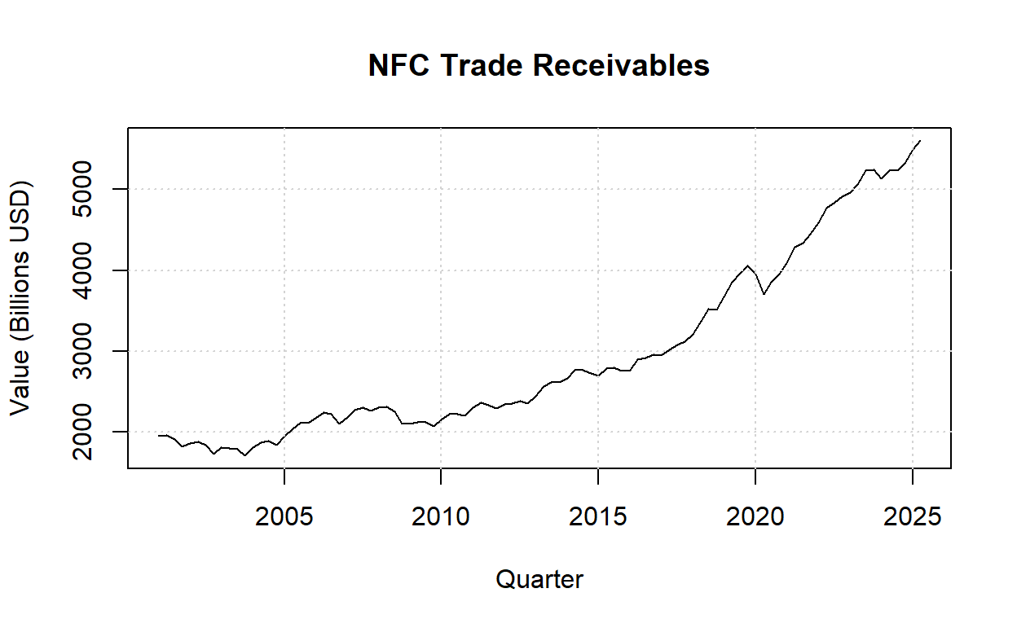
Exploration
Notes:
1. The overall trend is clear upward. The level climbed fast through 2010 to 2019. There is one obvious shock around 2020. May caused by the pandemic. Then, the trend has risen the fastest since 2021.
2. Seasonality looks weak. I don’t see a stable, repeating pattern in the plot. Comparing to the overall trend, wiggles between quarters are small relative.
3. Current level is the highest.

Slide 7
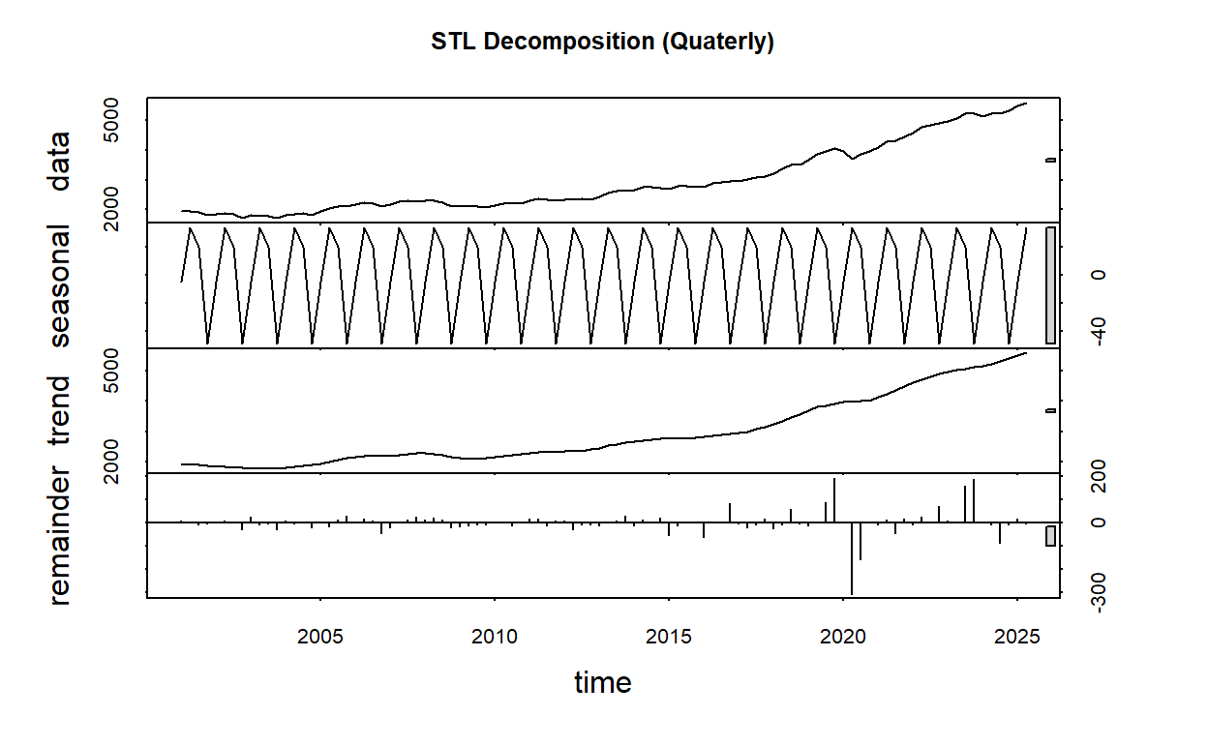
Exploration - Decomposition
Notes:
2. Seasonality is weak and stable over time, so it is additive because size of the wiggle stays the same as the level rises.
3. Steady uptrend.
4. Residuals are mostly small values centered around zero, with spikes around shocks (e.g., 2020).

Slide 8
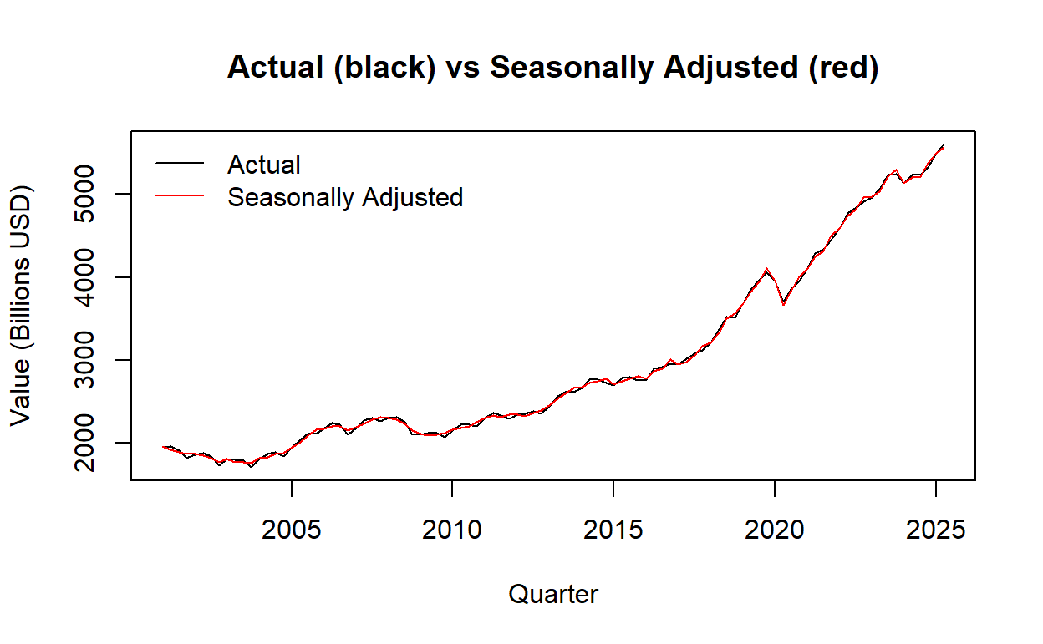
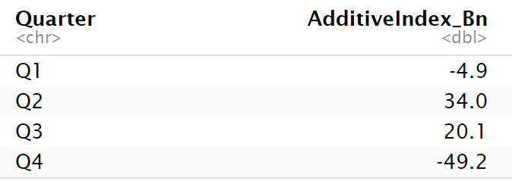
Exploration - Decomposition
seasonal monthly indices
Notes:
After seasonal adjustment, the red seasonally adjusted line almost overlaps the black actual line. This shows that the seasonal effect is small and stable, so the change of trend drives by shocks.

Slide 9
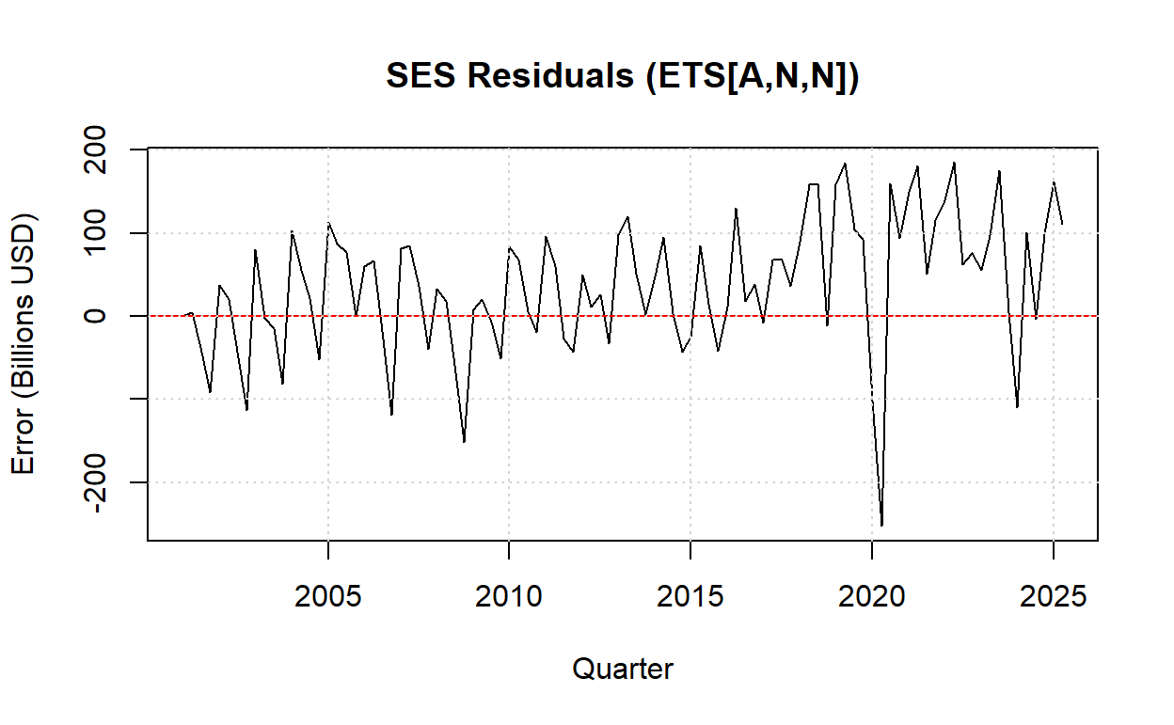
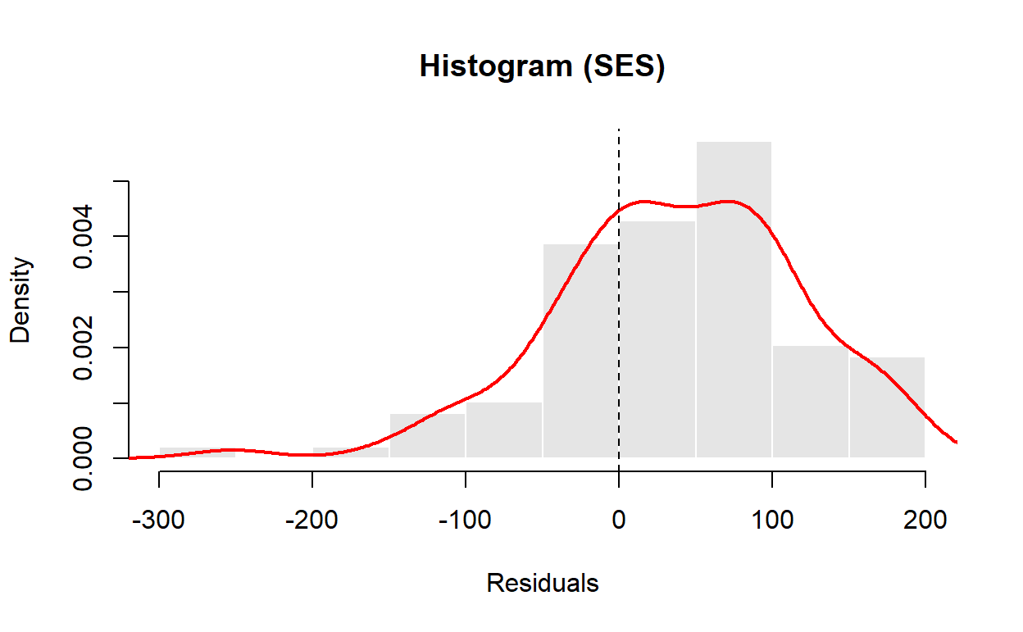
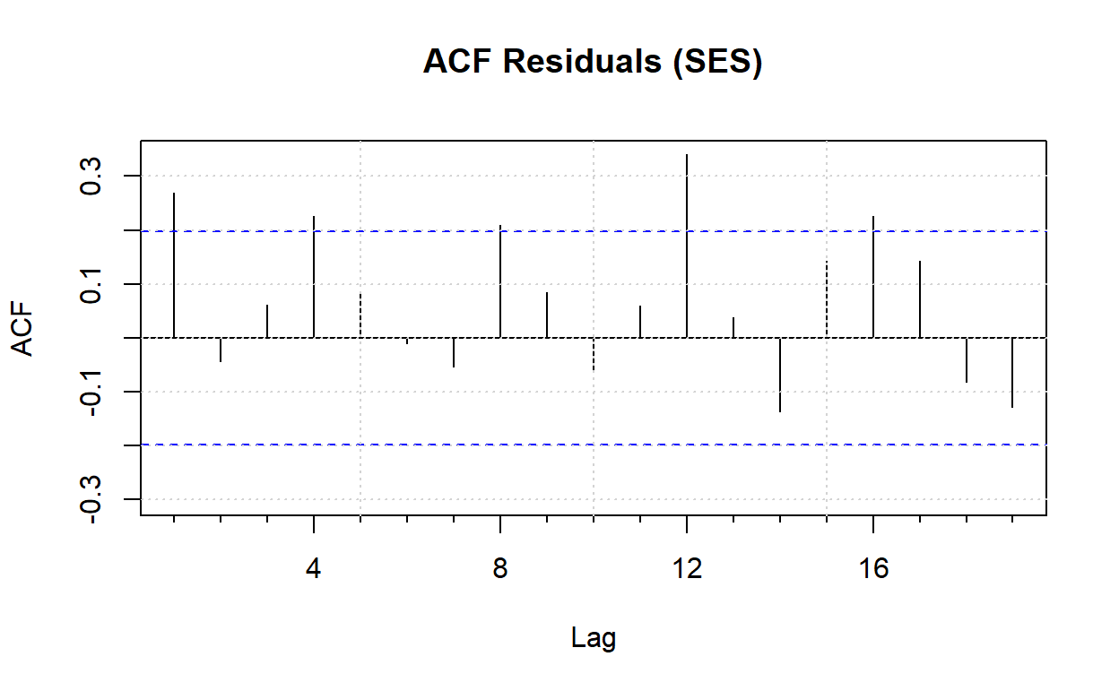
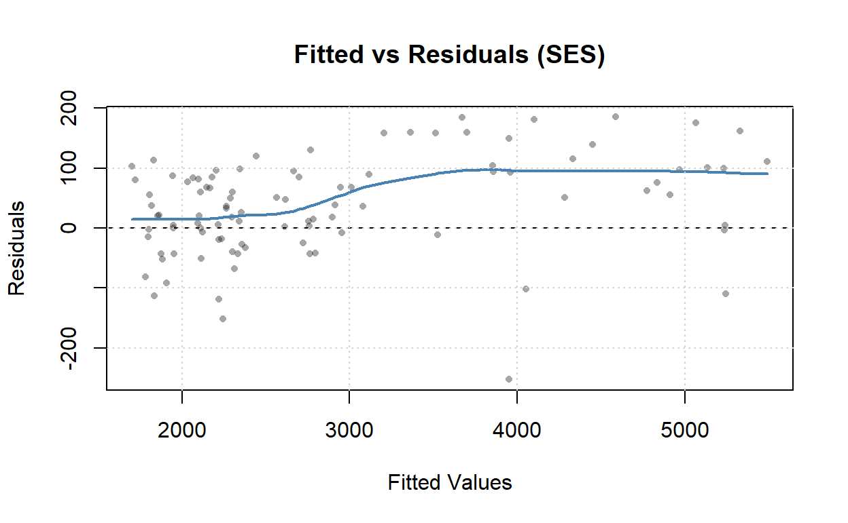
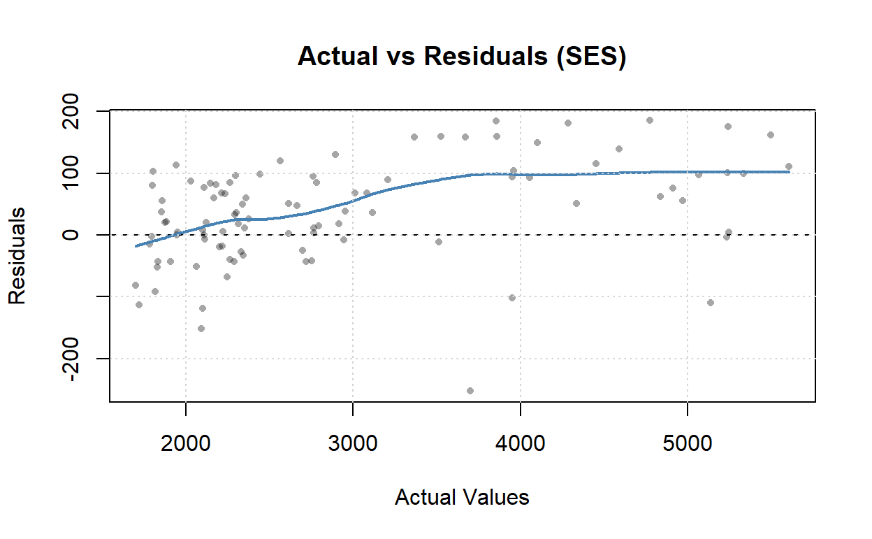
Exploration - SES
Notes:
The overall trend is consistently upward, but there was a significant drop in 2020, but it quickly recovered. There is a small bump appears after a 4-period lag. This indicate the data has quarterly seasonality, though it is weak and stable. Residuals have mostly been positive since 2015. It shows that actual values are frequently greater than forecasts, so the SES model tends to under-forecast. Finally, SES only captures “levels” and fails to capture ‘trends’ and “seasonality.”

Slide 10
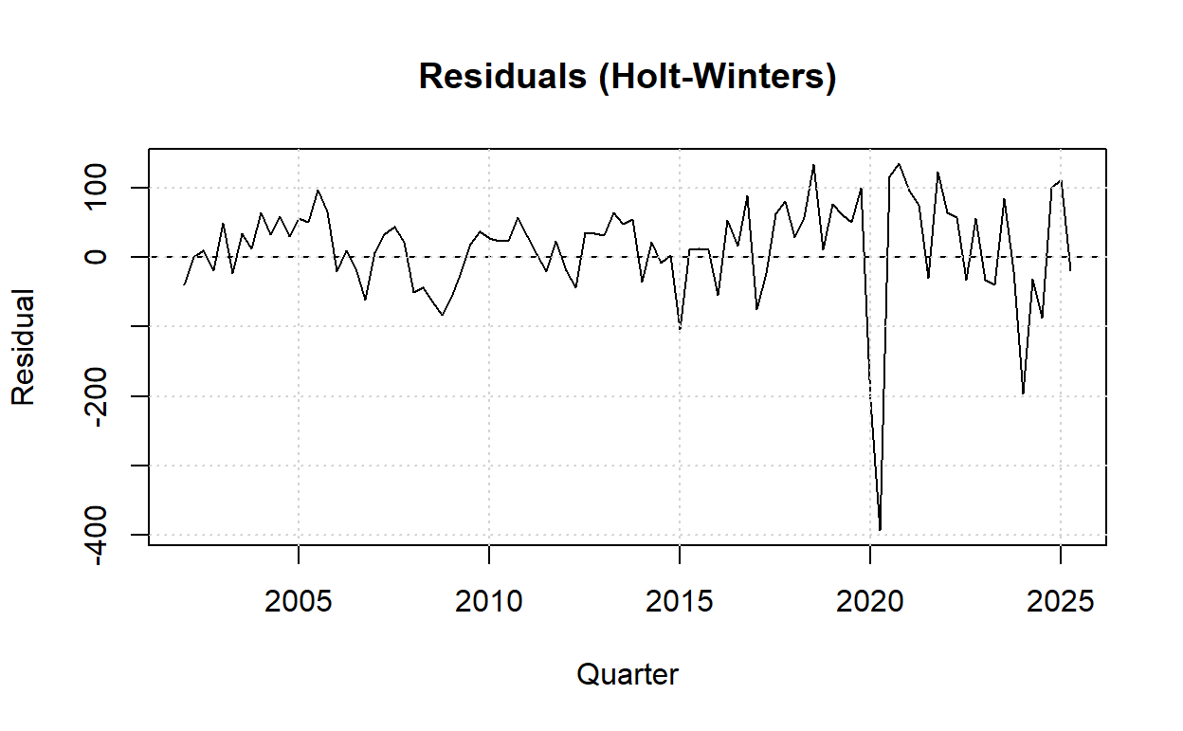
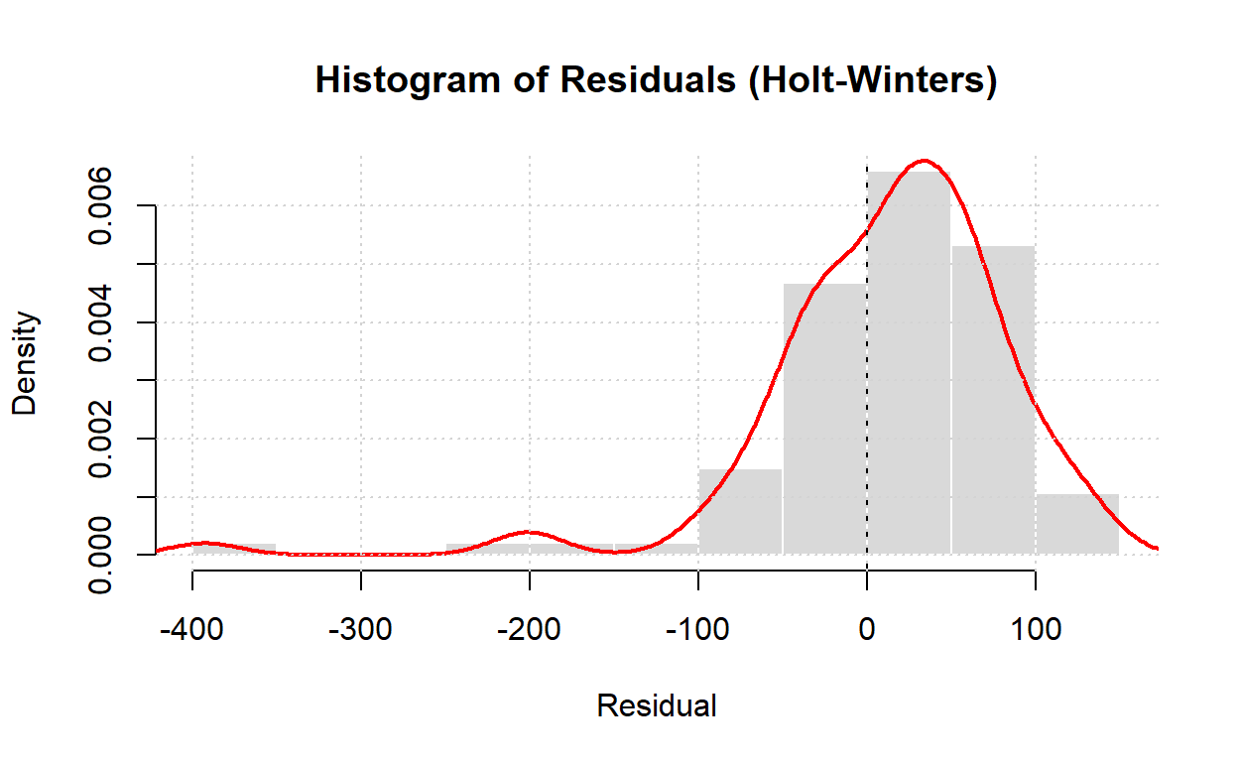
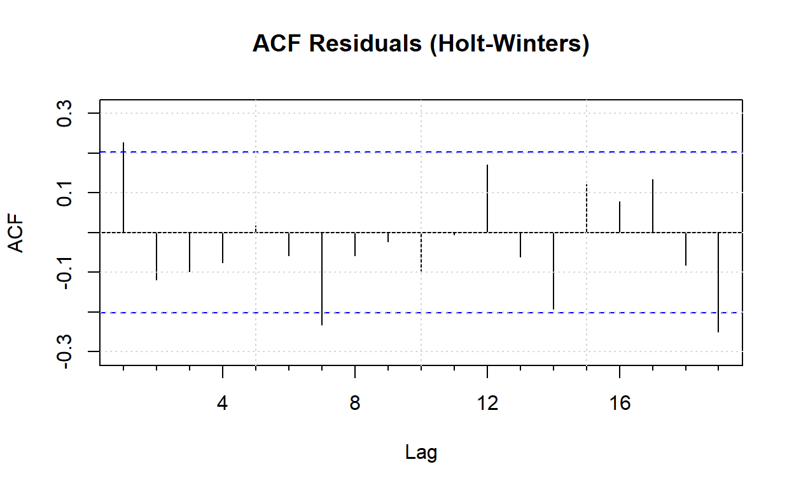
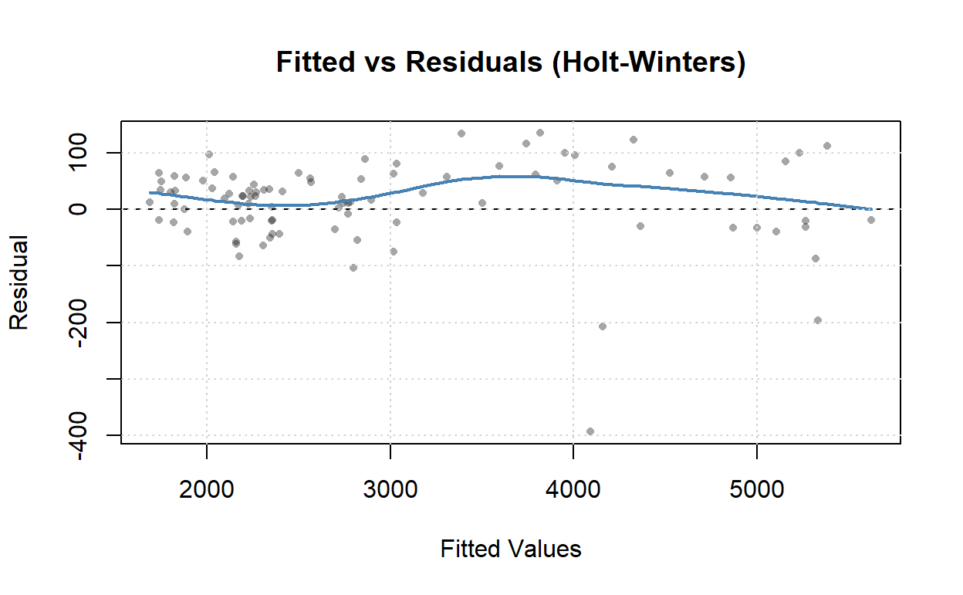
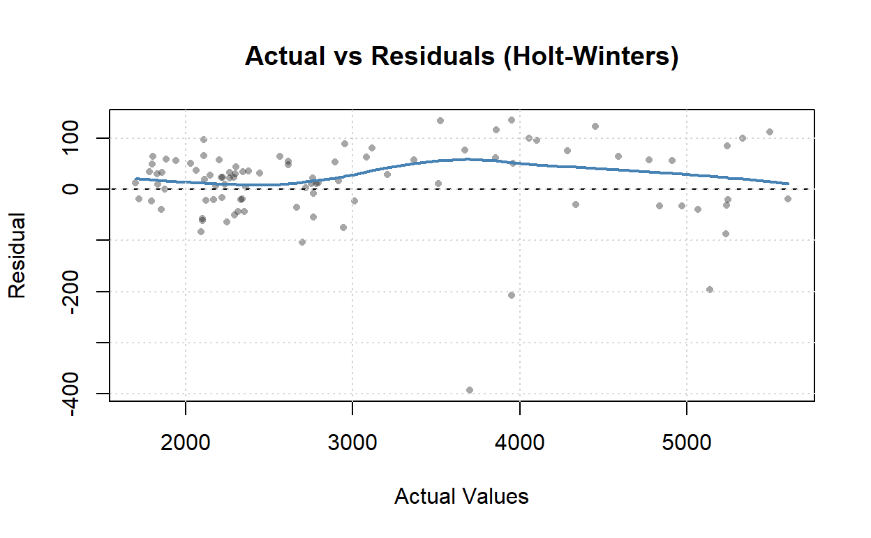
Exploration - Holt-Winters
Notes:
Comparing to SES plots, Holt-Winters model has most residuals closer to zero, but there is still a mild under-forecast on average. Spread is tight in the histogram. In AFC plot, most bars are inside the blue limits. There is a small spike at lag 1 and a couple of bars close to the bounds and near seasonal lags. Overall looks close to white noise. Only little leftover correlation. Holt-Winters captures level, trend, and stable quarterly seasonality, so it tracks the rising trend better and reacts more sensibly around seasonal turns.

Slide 11
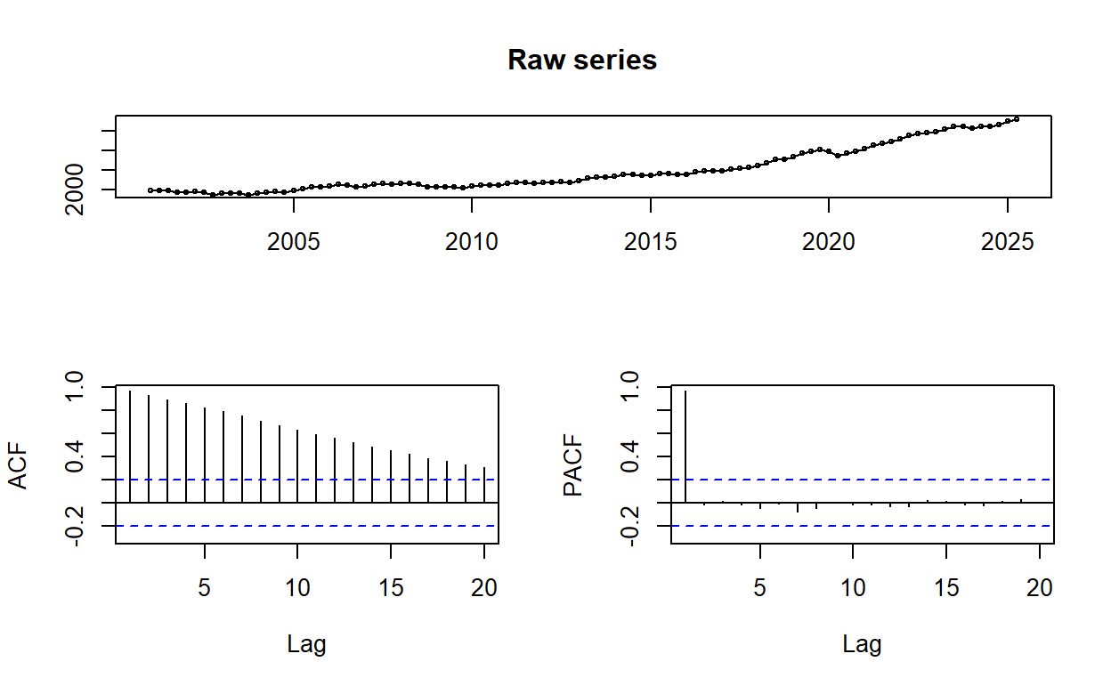
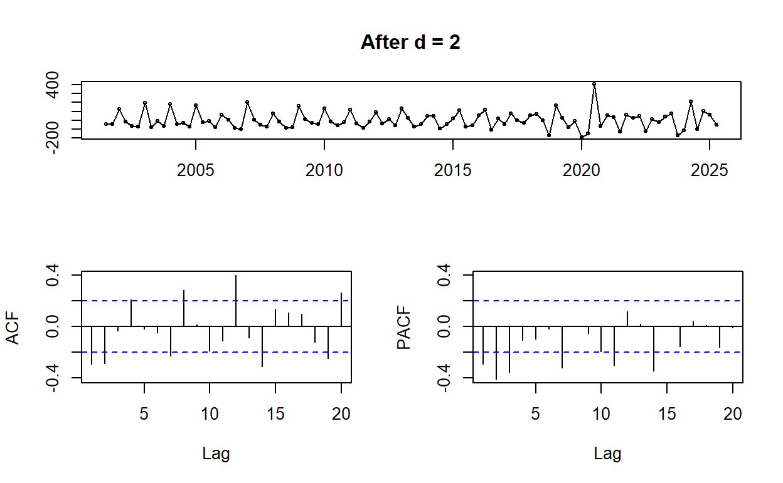
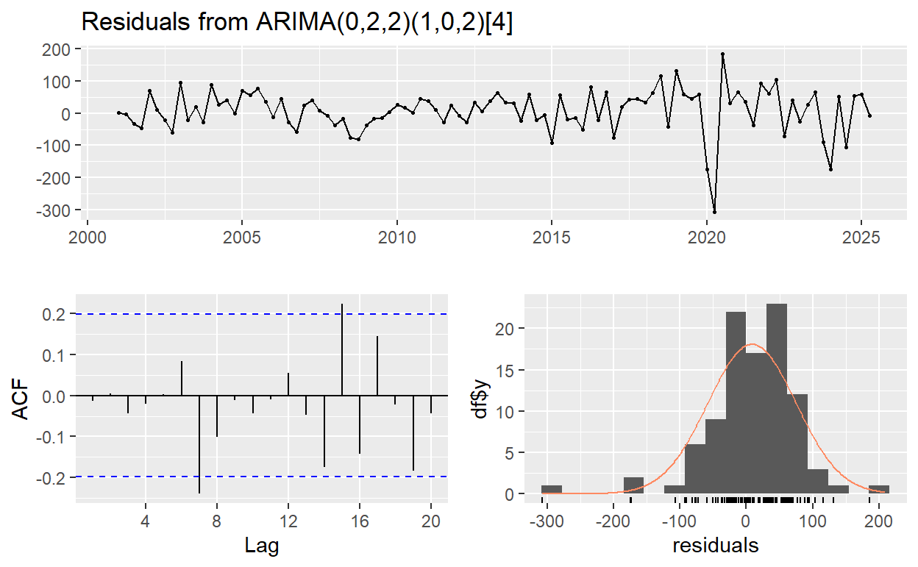
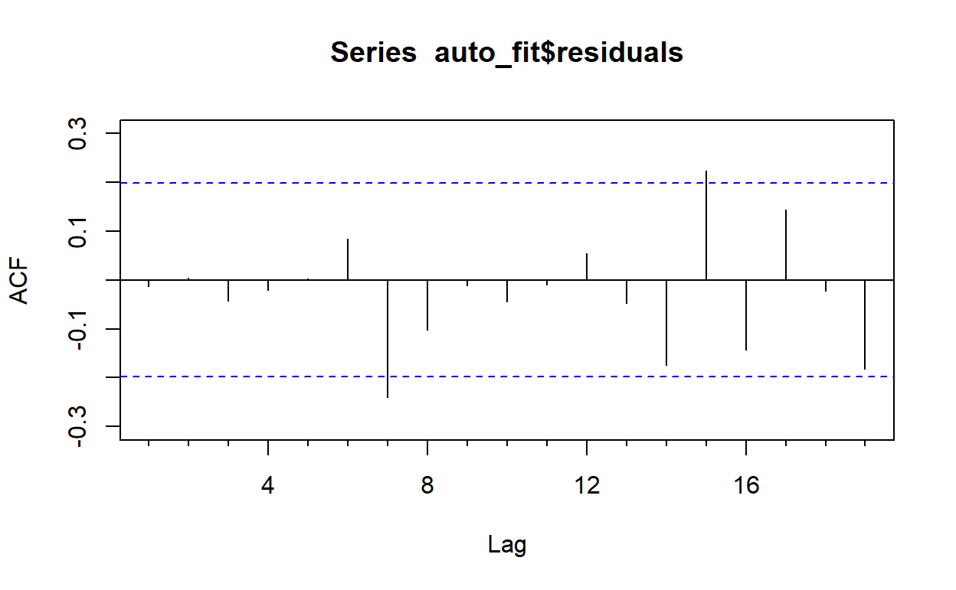
Exploration - ARIMA
Notes:
For the raw series, trend line goes up over time except a small drop in 2020. The trend of ACF shows a low decay, and there is a small bump near lag 4. The trend and quarterly seasonality are small and unstable, so it needs differencing.
After differencing (d = 2), trend has been removed. The plot looks more stationary. Most bars are small, and there is small signal near lag 4. This shows that there is a seasonal term at 4.
For the residual ACF, bars are inside the blue limits, so there is little autocorrelation left.

Slide 12
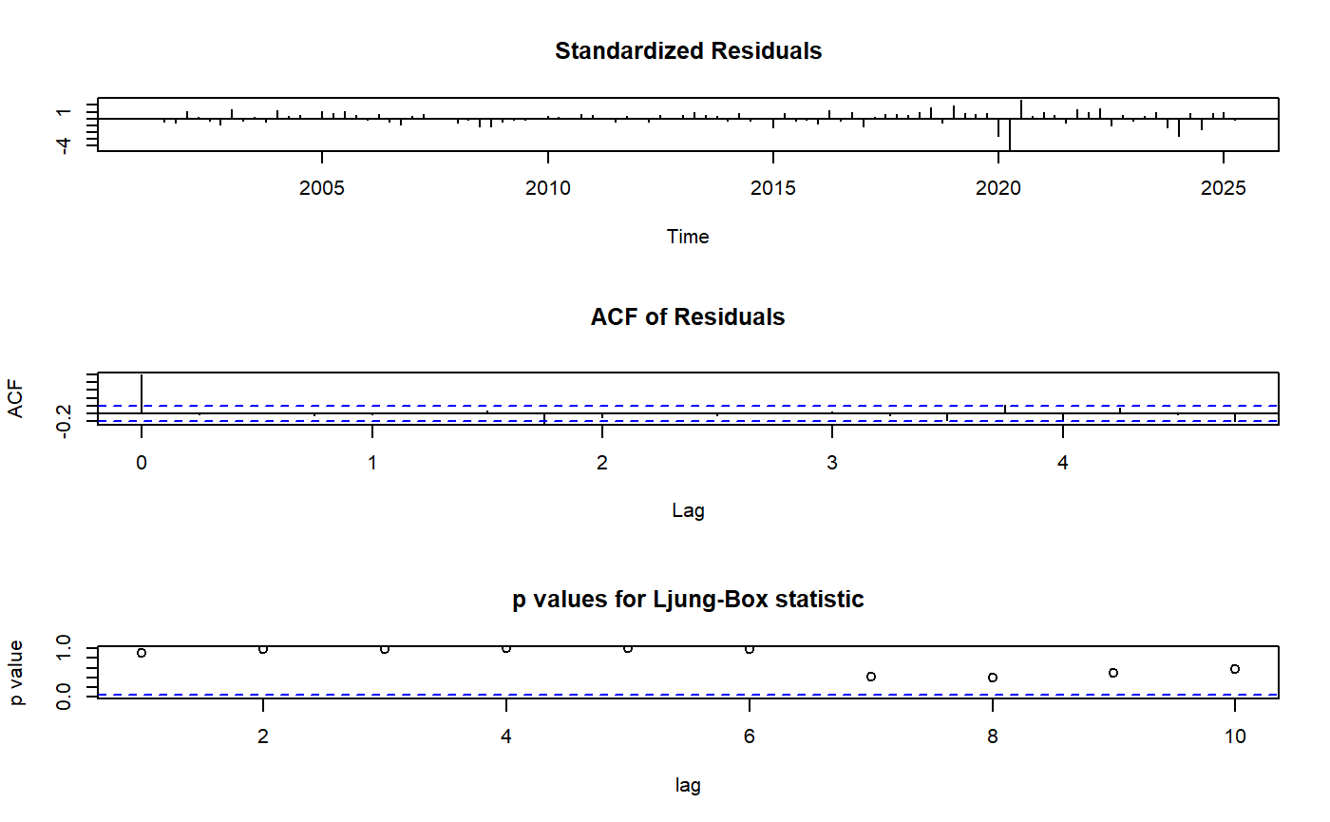
Exploration - ARIMA
Notes:
Standardized Residuals: There are no clear trend or cycle, and most of lags are close to zero. So this is good.
ACF of Residuals: All bars are inside the blue line limits. That means no meaningful autocorrelation is left at short lags. More accurately, the recent mistakes may not predict the next few quarters' mistakes.
Ljung-Box p-values: The dots are under the 0.05 line. So the model fails to reject “white noise.” The residuals look random.

Slide 13
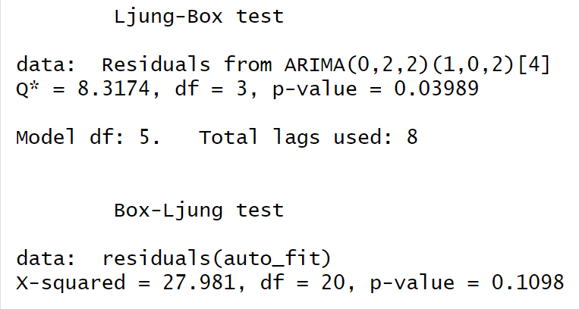
Judgement - ARIMA
Model picked: ARIMA(0,2,2)(1,0,2)[4]. Two regular differences, quarterly seasonality, MA(2) with seasonal AR(1) and MA(2).
Ljung–Box (checkresiduals, up to lag 8): Q* ≈ 8.32, p ≈ 0.040. Slight hint of short-lag correlation.
Box–Ljung (up to lag 20): X² ≈ 27.98, p ≈ 0.110. No evidence of leftover autocorrelation over more lags.
Notes:
Ljung-Box at short lags up to lag 8, checkresiduals:
Q* = 8.317, df = 3, p = 0.0399.
p-value is slightly below 0.05, so there is a small hint of short-lag correlation influenced by the 2020 outlier.
Box-Ljung at more lags up to lag 20:
X² = 27.981, df = 20, p = 0.1098.
p-value is above 0.05, so no evidence of autocorrelation over a broader range.
Overall judgment: Taking both tests and the residual plots together, there is no strong leftover autocorrelation. The ARIMA model is acceptable and good enough for forecast this time series.

Slide 14
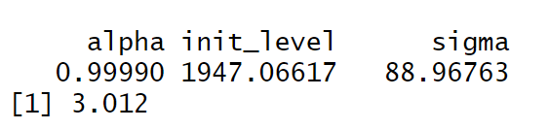
Judgement - SES
Alpha (α) ≈ 0.9999 ≈ 1.0
Almost all weight is on the latest quarter. The forecast is basically the last observed value repeating. Historical data has very little influence.
Initial level ≈ 1,947B USD
The starting baseline at the beginning of the series. It mainly affects the early fitted points, then decreasing its impact quickly when new data updated.
Sigma ≈ 88.97 B USD
Typical one-step error size. That is about 3.0% of the current level. Very small bias.
Notes:
When α ≈ 1, SES model tracks the last point value and produces same values for the next 4 quarters. Because the series is rising, the setup is under-forecast.

Slide 15
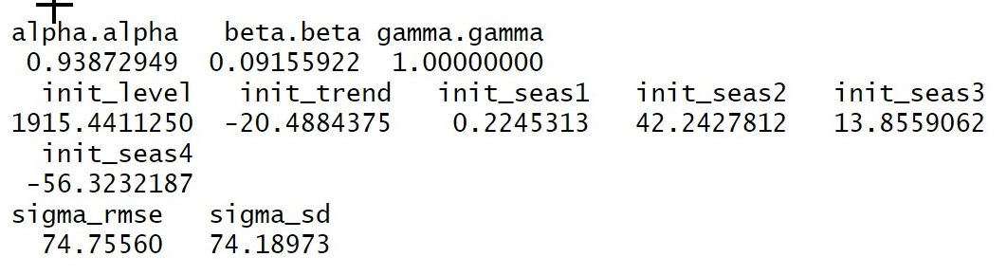
Judgement - Holt-Winters
Alpha ≈ 0.94. Puts a lot of weight on the newest level. Reacts fast to new data.
Beta ≈ 0.09. Small weight on the trend. Trend updates slowly.
Gamma = 1.00. Seasonality updates very quickly.
Initial level ≈ 1,915.44B. Starting baseline at the first point.
Initial trend ≈ −20.49B per quarter. At the start the slope was falling by about 20.49B each quarter.
Initial seasonal indices (additive, first year): Q1 ≈ +0.22B, Q2 ≈ +42.24B, Q3 ≈ +13.86B, Q4 ≈ −56.32B
Q2 is the strongest quarter. Q4 is the weakest.
Sigma (RMSE) ≈ 74.76B, Sigma (SD of residuals) ≈ 74.19B. Two very close values, means residuals are centered near zero and look like white noise.
Notes:
Alpha is roughly equivalent to 1. It means the model reacts fast to new data. Beta is small, so the trend updates slowly. Gamma is 1. Seasonality updates very quickly. The number of the initial level is the starting baseline at the first point. Initial trend is −20.49B per quarter. It means at the start, the model assumed the level was falling by about this number each quarter. For the initial seasonal indices, Q2 is the strongest quarter. Q4 is the weakest.
Sigma (RMSE) is close to Sigma (SD of residuals). This means that residuals are centered near zero and look like white noise.

Slide 16
Recommendation
ARIMA: Lowest errors AND Trend AND slight quarterly seasonality.
 | ME | RMSE | MAE | MAPE
SES | 37.341 | 88.055 | 70.183 | 2.411
Holt-Winters | 11.951 | 74.756 | 53.810 | 1.790
ARIMA | 8.333 | 66.982 | 49.749 | 1.700
Notes:
RMSE and MAE are typical dollar errors in billions. MAPE is average % error, lower is better. In this time series, the ARIMA model shows low error. MAE ≈ $49.75B and MAPE ≈ 1.70%. For a macro quarterly level series, 1~2% is solid. RMSE ≈ $66.98B indicates large misses are limited. ME ≈ $8.33B is a small positive bias (slight over-forecast). Overall, the model is accurate on this scale.

Slide 17
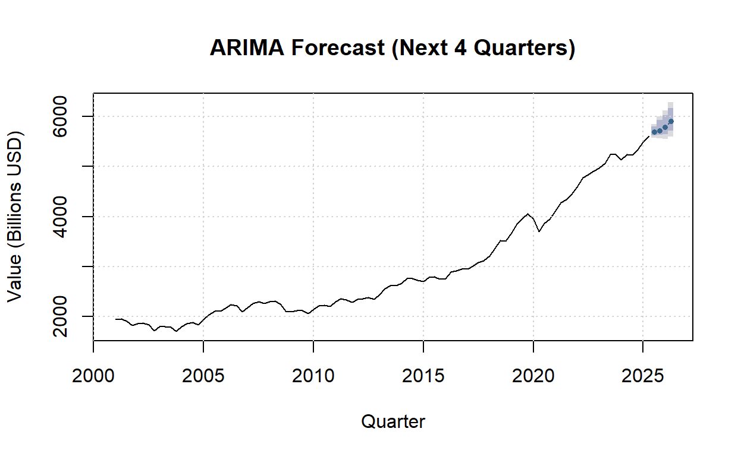
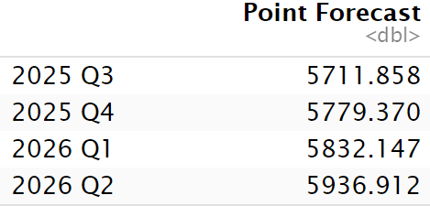
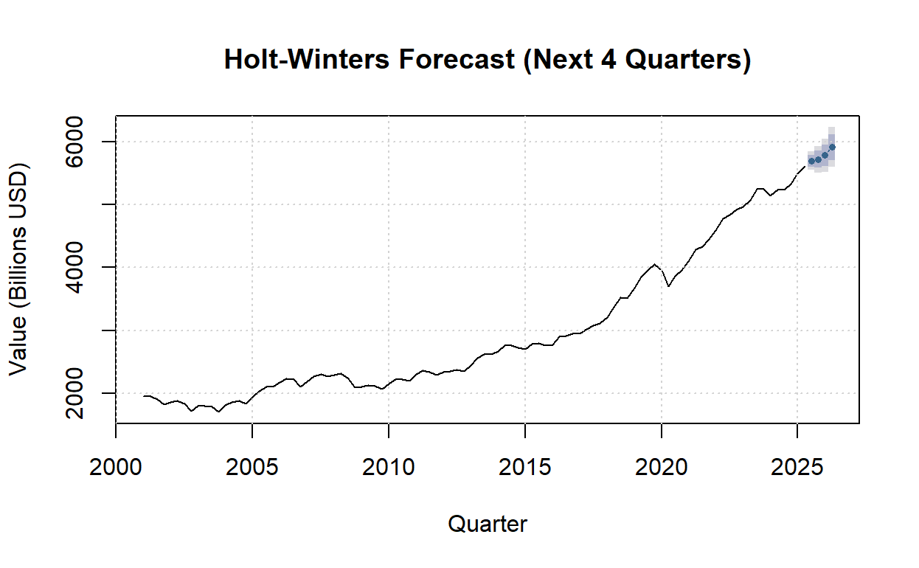
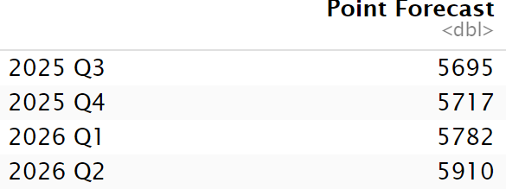
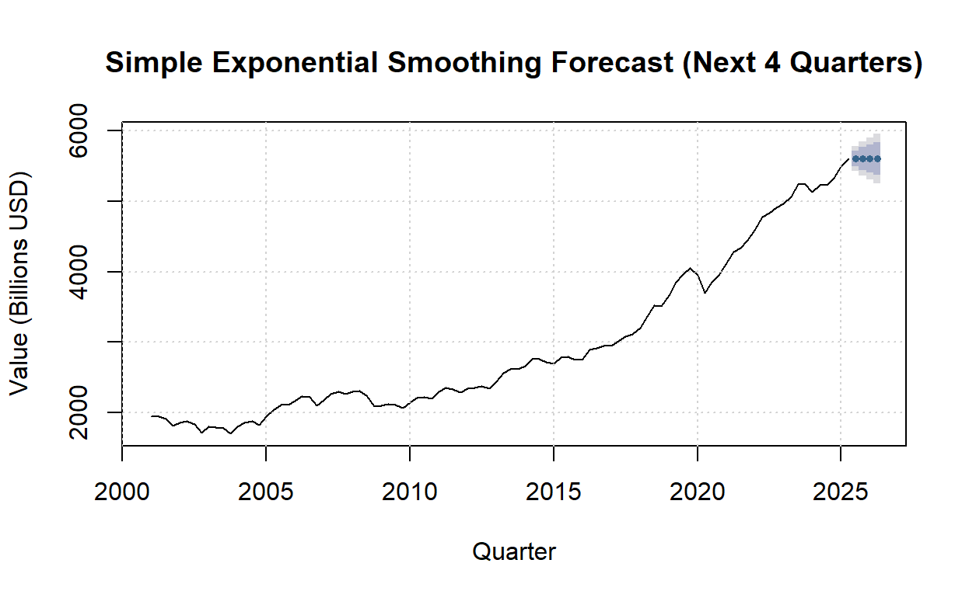
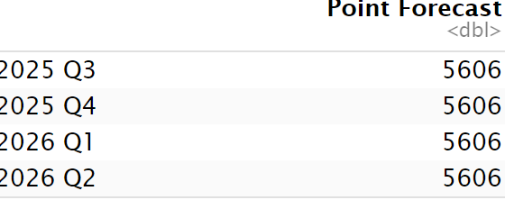
Forecast
ARIMA
Holt-Winters
Simple Exponential Smoothing
Notes:
If we use ARIMA forecast, the trend is up each quarter. Increase over the year is about +$225B. Roughly 4% growth.

Slide 18
Conclusion
Receivables will keep rising. The US NFC may prepare for a larger working-capital need next year.
If the day sales outstanding (DSO) stays the same, more cash will be tied up in AR. If DSO extends, the cash need will grow faster.
Set collections targets early. Credit limits should be restricted for weaker buyers if macro risk increases.
Use the 95% ranges to size best and worst case of cash needs. Upper band near $6,280B by 2026 Q2. Lower band near $5,590B.

Slide 19
Improvement
Mark 2020 as a special shock, not a recurring pattern to avoid the model chasing it.
Add a few drivers with ARIMAX, like PMI new orders, GDP growth, and interest rates.
Use rolling-origin cross-validation to pick the model and try a simple blend of ARIMA + Holt-Winters.

Slide 20
THANKS!
DO YOU HAVE ANY QUESTIONS?

